Slide 1
BI 232 Laboratory Circulatory System: Cardiac Anatomy
Notes:
Saladin A&P Unity of Form and Function 6e

Slide 2
The Heart
Cardiovascular system
Consists of heart and blood vessels.
Heart
Muscular pump keeping blood flowing through vessels.
Delivers blood to all organs and tissues and returns to heart.
> 1 million gallons per year.
> 60,000 miles of blood vessels.
Circulatory system
Includes blood.
Some academic circles include lymphatics.
Notes:
Saladin A&P Unity of Form and Function 6e

Slide 3
Position, Size, and Shape of the Heart
Located in mediastinum, between lungs.
Mediastinum - contains the heart, thymus, esophagus, trachea, phrenic and cardiac nerves
Base
Broad superior portion of heart.
Extends from inferior border of left 2nd costal cartilage to superior border of right 3rd costal cartilage.
Apex
Inferior end, tilts to the left, tapers to point.
Positioned at left 5th intercostal space just left of median plane.
Notes:
Saladin A&P Unity of Form and Function 6e

Slide 4
Heart Wall
Epicardium
AKA: visceral pericardium
Serous membrane covers heart.
Myocardium
Thick muscular layer.
Fibrous skeleton.
Network of collagenous and elastic fibers.
Provides structural support.
Attachment for cardiac muscle.
Nonconductor important in coordinating contractile activity.
Endocardium
Smooth inner lining.
Notes:
Retrieved from http://classconnection.s3.amazonaws.com/82/flashcards/2839082/png/heart_wall1318423923236-thumb4001361728899278.png, 2014

Slide 5
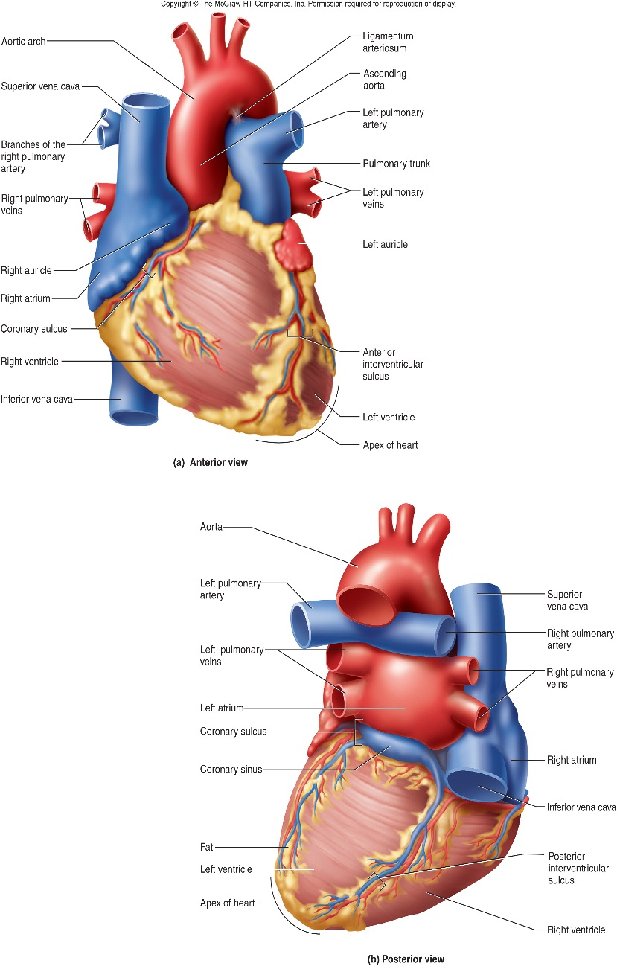
Heart Consists of Four Chambers
Four chambers
2 atria (right and left).
2 ventricles (right and left).
Sulci
Grooves on surface containing coronary blood vessels and fat.
Atrioventricular sulcus (Coronary sulcus)
Boundary between atria and ventricles.
Anterior interventricular sulcus
Boundary between the ventricles anteriorly.
Posterior interventricular sulcus
Boundary between the ventricles posteriorly.
Notes:
Saladin A&P Unity of Form and Function 6e

Slide 6
Pulmonary vs. Systemic Circuit
Right side of heart
O₂ poor blood delivered via superior and inferior vena cava.
Sent to lungs via pulmonary trunk -> pulmonary arteries
Left side of heart
O₂ rich blood sent from lungs via pulmonary veins.
Blood sent to all body tissues via aorta.
Notes:
Saladin A&P Unity of Form and Function 6e

Slide 7
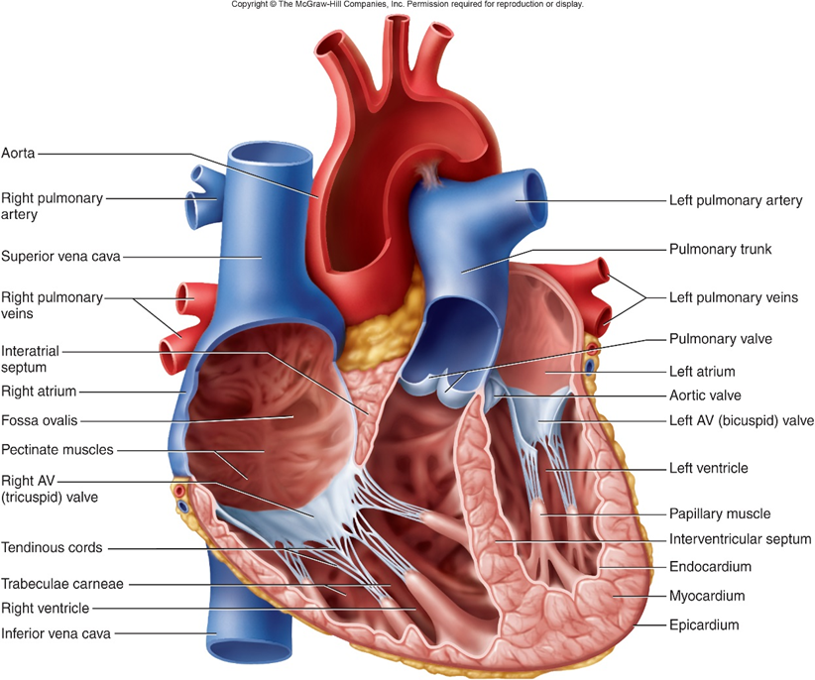
Right Atrium
Receives blood from three sources.
Superior vena cava
Inferior vena cava
Coronary sinus
Interatrial septum
Partitions the atria.
Auricle (right atrial appendage-RAA)
Small, cone-shaped pouch, upper-front portion of atrium overlapping aortic root.
Atrium and auricle both lined with thick pectinate (comb) muscle on inner surface.
Fossa ovalis
Remnant of fetal foramen ovale.
Tricuspid valve (R atrioventricular)
Blood flows through into right ventricle.
Three cusps of dense CT covered by endocardium.
Notes:
Saladin A&P Unity of Form and Function 6e

Slide 8
Right Ventricle
Forms most of anterior surface of heart.
Papillary muscles
Cone shaped trabeculae carneae.
Raised bundles of cardiac muscle.
Chordae tendineae
Anchor tricuspid valve to papillary muscles.
Trabeculae carneae (meaty ridges)
Rounded or irregular muscular columns projecting from inner surface of ventricles.
Interventricular septum
Partitions right and left ventricles.
Pulmonary semilunar valve
Blood flows into pulmonary trunk.
Notes:
Saladin A&P Unity of Form and Function 6e

Slide 9
Left Atrium
Forms most of the base of heart.
Receives blood from lungs.
4 pulmonary veins.
2 right and 2 left.
Auricle (left atrial appendage - LAA)
Small, muscular pouch at upper corner left atrium.
Atrium and auricle both lightly lined with pectinate muscle on inner surface.
Bicuspid valve (left atrioventricular valve or Mitral)
Two cusps of dense CT covered by endocardium.
Blood passes into left ventricle.
Notes:
Saladin A&P Unity of Form and Function 6e

Slide 10
Left Ventricle
Forms the apex of heart.
Papillary muscles
Cone shaped trabeculae carneae.
Raised bundles of cardiac muscle.
Chordae tendineae
Anchor bicuspid valve to papillary muscles.
Trabeculae carneae like right ventricle.
Interventricular septum
Partitions right and left ventricles.
Aortic semilunar valve
Blood passes through valve into ascending aorta.
Above valve are openings to coronary arteries.
Notes:
Saladin A&P Unity of Form and Function 6e

Slide 11
Vessels of the Heart
PULMONARY
Superior vena cava
Inferior vena cava all convey deoxygenated blood to heart.
Coronary sinus
Pulmonary trunk – conveys deoxygenated blood to lungs.
Right pulmonary artery
Left pulmonary artery
SYSTEMIC
Pulmonary veins (right and left) – conveys oxygenated blood to left atrium.
Aorta – conveys oxygenated blood to systemic arteries.
Ascending
Aortic arch
Descending (thoracic)
Ligamentum arteriosum (arterial ligament) – fetal remnant of ductus arteriosus (fetal structure shunting blood from pulmonary arteries to aorta avoiding circulating blood in lungs)

Slide 12
Vessels of the Heart
Notes:
Posterior view of heart retrieved from http://image.slidesharecdn.com/ch21lecturepresentation-140918213639-phpapp02/95/ch-21lecturepresentation-14-638.jpg?cb=1411076332, 2016
Anterior view of heart retrieved rom http://158.132.198.175/lexicon/web/tmp_img/a619260dd04f7fe872f7ec14740c2320.jpg, 2016

Slide 13
4 Heart Valves
Ensure one-way blood flow.
2 atrioventricular (AV) valves
Right AV valve has 3 cusps (tricuspid valve).
Left AV valve has 2 cusps (mitral, bicuspid valve).
Chordae tendineae
Cords connect AV valves to papillary muscles.
Control flow into great arteries.
2 semilunar valves
Pulmonary semilunar valve
From right ventricle into pulmonary trunk.
Aortic semilunar valve
From left ventricle into aorta.
Notes:
Retrieved from http://sundar.me/wp-content/uploads/2011/03/heart-valves-from-above.gif, 2014

Slide 14
Blood Flow Through Heart
Flow of blood through heart is from right atrium throughout the body and back again
Video on the pathway of blood through the heart
Notes:
Saladin A&P Unity of Form and Function 6e
Every thing is controlled by God. (2010, January). How the Heart Works 3D Video. flv [video file]. Retrieved from https://www.youtube.com/watch?v=oHMmtqKgs50

Slide 15
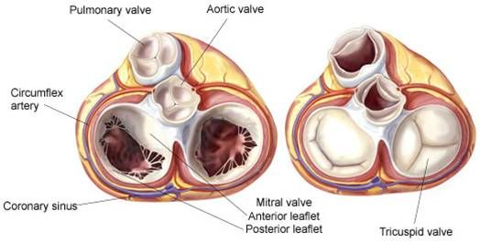
Position of the Heart Valves Relative to VENTRICULAR Diastole and Systole
Diastole: atria contract and ventricles relax=filling
Ventricles relax.
Pulmonary and aortic valves close (no backflow).
AV valves open.
Ventricles fill (about 80% of capacity).
Atria contract (ventricles fill another 20%).
Systole: ventricles contract and atria relax.
Ventricles contract.
AV valves close.
Aortic and pulmonary valves open.
Blood is ejected.
Atria relax and fill with blood.
Notes:
Retrieved from http://www.macts.com/assets/image-cache/home/afibcenter/public_html/images/valve/valves.9898ef67.jpg, 2016

Slide 16
Coronary Circulation: Blood Supply to the Heart
Heart relaxes…
High pressure of blood in aorta pushes blood into coronary vessels.
Many anastomoses…
Connections between arteries supplying blood to same region.
Provide alternate routes if an artery becomes occluded.
Notes:
Retrieved from https://soperedi.files.wordpress.com/2013/07/4cc8b-1.jpg, 2016

Slide 17
Coronary Arteries
Left coronary artery
Left Anterior interventricular artery
AKA: Left anterior descending (LAD)
Circumflex artery
Left marginal artery
Right coronary artery
Right marginal artery
Posteriorly right coronary becomes…
Posterior interventricular artery
AKA: Right posterior descending artery (PAD)
Anterior and posterior interventricular arteries form anastomosis near apex.
Notes:
Retrieved https://upload.wikimedia.org/wikipedia/commons/c/c9/Coronary_arteries.png, 2016

Slide 18
Coronary Veins
Great cardiac vein
Descends anterior interventricular sulcus.
Posterior cardiac vein
Middle cardiac vein
Ascends posterior interventricular sulcus
Coronary sinus
Lies in coronary sulcus.
Empties into right atrium.
Notes:
Retrieved from http://websupport1.citytech.cuny.edu/faculty/ibarjis/Teaching/Anatomy%20and%20Physiology/lecture20/Lecture/Figure6.jpg, 2016

Slide 19
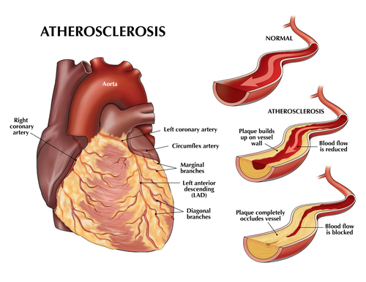

Slide 20
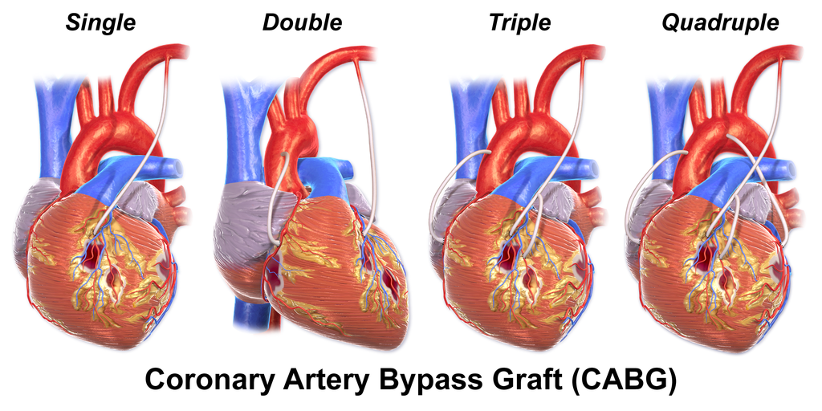

Slide 21
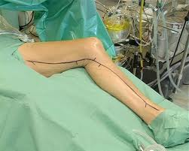

Slide 22
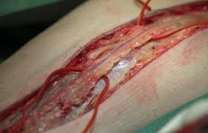

Slide 24
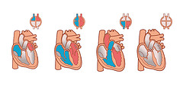
Blood Flow, Heart Sounds, and Cardiac Cycle
Heart is a muscular pump: two pumps acting in unison.
Cardiac cycle
A full contraction and relaxation of all four heart chambers.
Atrial systole
Contraction
Occurs when ventricles are relaxed (diastole).
Atrial diastole
Relaxation
Occurs when ventricles are contracted (systole).
Quiescent period
Simultaneous relaxation of all four chambers.
Notes:
Retrieved from http://farm2.static.flickr.com/1267/1337308380_2c824294be_m.jpg, 2014

Slide 25
Heart Sounds
Auscultation
Listening to sounds made by body.
First heart sound (S1)
Louder and longer “lubb”.
Occurs with closure of AV valves.
Second heart sound (S2)
Softer and sharper “dupp”.
Occurs with closure of semilunar valves.
S3
Rarely heard in people > 30.
Video on heart sounds
This video is intended for home study.
Notes:
Saladin A&P Unity of Form and Function 6e
Khanacademymedicine. (2012, October). Lubb Dupp [video file]. Retrieved from http://www.youtube.com/watch?v=-4kGMI-qQ3I

Slide 26
Defining and Performing Auscultation of the Heart
Action of listening to sounds from the heart, typically with a stethoscope, as a part of medical diagnosis
Notes:
Legend retrieved from http://www.vetvisions.com/p411_files/Anatomy.gif, 2016
Model image retrieved from https://www.ole.bris.ac.uk/bbcswebdav/institution/Faculty%20of%20Health%20Sciences/MB%20ChB/Hippocrates%20Year%203%20Medicine%20and%20Surgery/Cardiology%20-%20Valvular%20heart%20disease/images/pic005.jpg, 2016

Slide 27
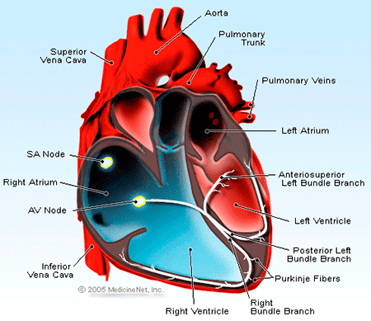
Anatomy of the Conduction System
Sinoatrial node (SA node)
Pacemaker, initiates heartbeat, sets heart rate.
Atrioventricular node (AV node)
Electrical gateway to ventricles.
Atrioventricular bundle (bundle of His)
Pathway for signals from AV node.
Right and left bundle branches
Divisions of AV bundle enters interventricular septum descending to apex.
Purkinje fibers
Upward from apex spread throughout ventricular myocardium.
Simulate cardiac muscle of ventricles to contract.
Notes:
Retrieved from http://images.medicinenet.com/images/illustrations/heartxsection.gif, 2016

Slide 28
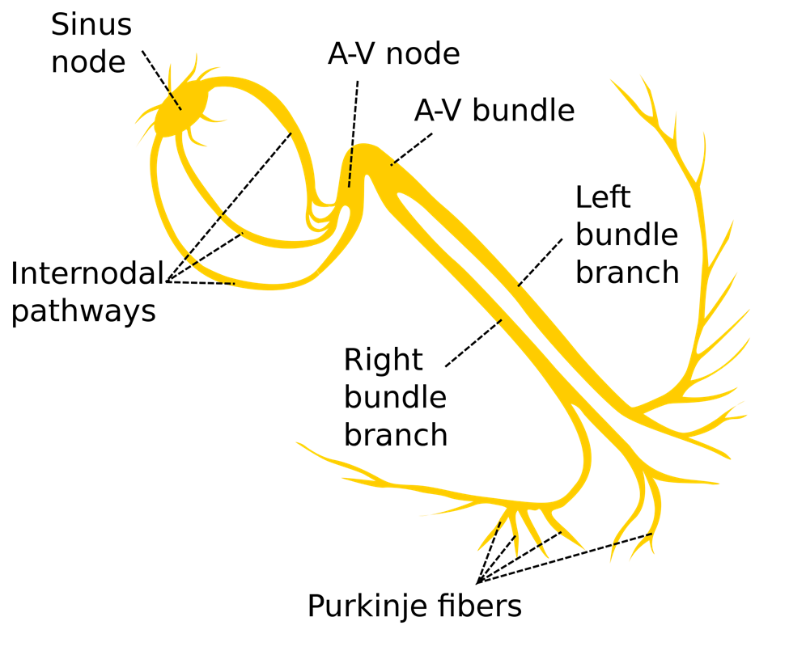
Electrical Activity of Heart Stimulates Muscle to Contract
Myogenic
Functioning in ordered rhythmic fashion due to inherent properties of myocyte cells outside of a specific neural stimuli
Autorhythmicity (automaticity).
Heartbeat originates within heart.
Autorhythmic
Regular, spontaneous depolarization.
Notes:
Retrieved from http://upload.wikimedia.org/wikipedia/commons/thumb/e/e7/Electrical_conduction_system_of_the_heart.svg/2000px-Electrical_conduction_system_of_the_heart.svg.png, 2014

Slide 29
Autorhythmicity and the Heart
Video on the conducting system of the heart
Notes:
Saladin A&P Unity of Form and Function 6e
McGraw-Hill Companies, Inc. (2014). Conducting System of the Heart [video file]. Retrieved from https://www.youtube.com/watch?v=te_SY3MeWys

Slide 30
Cardiac Rhythm
Systole (contraction)
Diastole (relaxation)
Sinus rhythm
Normal heartbeat triggered by SA node.
Ranges 60-100 BPM
SA node fires spontaneously 90-100x/min
Nodal rhythm
AV node fires at 40-50x/min
Artificial pacemaker needed if pace is too slow.
Extra beats forming at other sites.
Called ectopic focus.
Caffeine and nicotine increase activity.
Notes:
Retrieved from http://sr.photos3.fotosearch.com/bthumb/CSP/CSP994/k15824377.jpg, 2014

Slide 31
Electrical Activity of the Heart
Heart produces low-voltage electrochemical impulses.
Average potential difference is -90 millivolts.
Impulses can travel through saline medium of body and be picked up by sensors attached to skin.
Collective action potentials generated by atria and ventricles depolarizing and repolarizing can be recorded using an electrocardiograph EKG/ECG machine

Slide 32
Electrical Activity of Myocardium
Atrial depolarization begins.
Atrial depolarization complete (atria contracted).
Ventricles begin to depolarize at apex atria repolarize (atria relaxed).
Ventricular depolarization complete (ventricles contracted).
Ventricles begin to repolarize at apex.
Ventricular repolarization complete (ventricles relaxed).
Animation of cardiac conduction system and understanding EKG/ECG
Notes:
Saladin A&P Unity of Form and Function 6e
Alila Medical Media. (2014, April). Cardiac Conduction System and Understanding ECG, Animation [video file]. Retrieved from http://www.youtube.com/watch?v=RYZ4daFwMa8

Slide 33
Electrocardiogram (EKG/ECG)
Composite of all action potentials of nodal and myocardial cells detected, amplified and recorded by electrodes on arms, legs and chest.
EKG graph paper
Each small box: 0.04s
One large box: 0.20s
Voltage represented: .10mV/small box
Notes:
Saladin A&P Unity of Form and Function 6e

Slide 34
Interpreting the EKG: P wave, PR Segment and Interval
P wave
Represents atrial depolarization.
P-wave precedes QRS complex.
Shape is small, smooth, and rounded upwards from baseline.
Amplitude: 0.05 to 0.25mV (0.5 to 2.5 small boxes).
Duration: <0.12s (1.5 to 2.75 small boxes).
PR segment
From the end of P wave until beginning of QRS complex (onset of ventricular depolarization).
PR interval
Includes wave and segment (milliseconds).
Duration: 0.12 – 0.20s (3 to 5 small boxes)
Abnormalities: may indicate mitral valve stenosis or pulmonary hypertension.
Notes:
Retrieved from https://upload.wikimedia.org/wikipedia/commons/thumb/9/9e/SinusRhythmLabels.svg/2000px-SinusRhythmLabels.svg.png, 2016

Slide 35
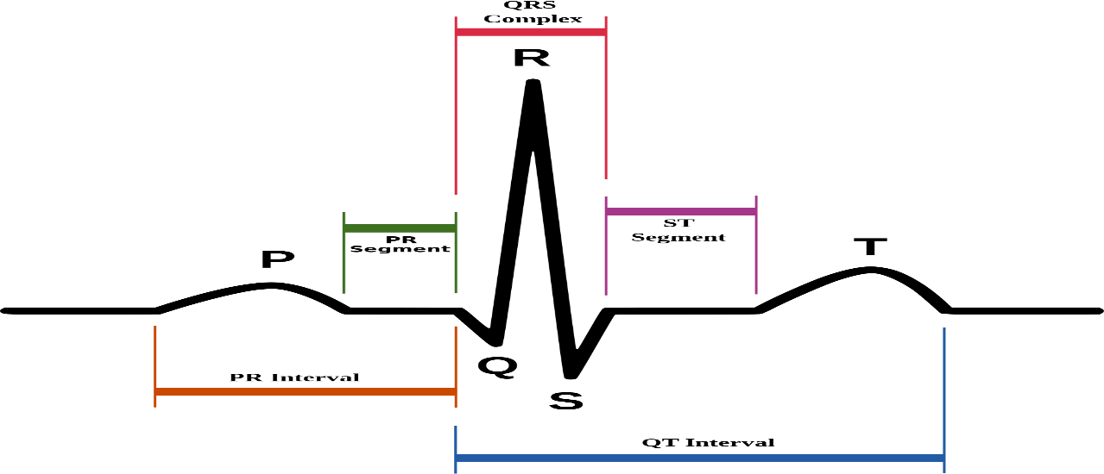
Interpreting the EKG: QRS Complex
QRS complex
Indicates ventricular depolarization (triggers contraction of ventricles).
Due to larger tissue mass, QRS complex is larger than P wave.
Consists of three wave components, but one or two of these components may be missing.
Wave immediately after P wave is upward deflection, then = R wave, downward = Q.
Duration: 0.06- 0.12s (1.5 to 3 boxes).
Q wave – depolarization of the ventricular septum (small downward deflection).
R wave – activation of most of the ventricle (large upward deflection).
S wave – last stage of ventricular depolarization (downward deflection).
RR interval - point corresponding to peak of QRS complex (R) and interval between successive R’s.
Duration: 0.60 to 1.0s (15 to 25 small boxes)
Notes:
Retrieved from https://upload.wikimedia.org/wikipedia/commons/thumb/9/9e/SinusRhythmLabels.svg/2000px-SinusRhythmLabels.svg.png, 2016

Slide 36
Interpreting the EKG: ST segment and T wave
ST segment
Time between end of the QRS complex and start of T wave.
Ventricle is contracting, but no electricity is flowing.
Usually even with baseline.
Represents the early part of ventricular repolarization.
AKA: ST interval
T wave
Ventricular repolarization.
Occurs before ventricular relaxation or diastole.
measure of time between start of the Q wave and end of T wave in the heart's electrical cycle. represents electrical depolarization and repolarization of the ventricles.
QT interval
Time from beginning of Q wave to end of T wave.
Normal QT length varies with heart rate (very fast rates shorten the QT length).
Duration: 0.42 – 0.44s (10.5 to 11 small boxes)
Notes:
Retrieved from https://upload.wikimedia.org/wikipedia/commons/thumb/9/9e/SinusRhythmLabels.svg/2000px-SinusRhythmLabels.svg.png, 2016

Slide 37
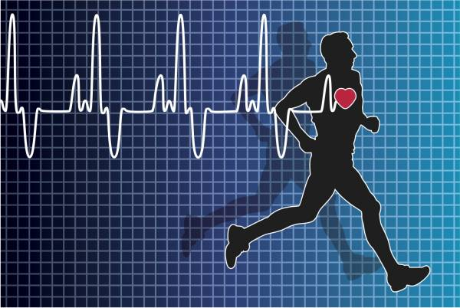
Heart Rate: Normal and Irregular
Measured from pulse.
EKG - "the rule of 300.“ Take the number of “big boxes” between neighboring QRS complexes, and divide this into 300. The result will be approximately equal to the rate.
Infants have HR of 120 beats per minute or more.
Young adult females avg. 72 - 80 bpm.
Young adult males avg. 64 to 72 bpm.
HR rises again in elderly.
Tachycardia
Persistent, resting adult HR > 100.
Stress, anxiety, drugs, heart disease or ↑body temp.
In small children may be considered normal.
Bradycardia
Persistent, resting adult HR < 60.
Common in sleep and endurance trained athletes (↑ SV).
Notes:
Retrieved from http://cdn2.omidoo.com/sites/default/files/imagecache/full_width/images/bydate/20130517/shutterstock88634599copy.jpg, 2016

Slide 38
Cardiac Arrhythmias
A major diagnostic use is to detect arrhythmias, abnormal rhythms of heart.
Atrial fibrillation: electrical activity of the heart is uncoordinated causing upper chambers to quiver.
Ventricular fibrillation: where electrical signals in ventricles fire in a very fast uncontrolled manner.
Notes:
On this EKG notice 2 normal heart beats then a PVC (premature ventricular contraction) and then 2 normal beats. Occasional PVCs nothing to worry about but if happens frequently may need treatment.
Retrieved from http://bdml.stanford.edu/twiki/bin/view/Haptics/CatheterForceSensing.html, 2016

Slide 39
Premature Ventricular Complexes (PVC)
Electrical signal causes an early heartbeat that usually goes unnoticed.
Extra abnormal heart beats that begin in one of the ventricles
Can have occasional PVCs if you are a generally healthy person but if you have frequent PVCs you may need treatment.

Slide 40
Heart Blocks: Atria and Ventricles
Heart Block = reduced conduction between atria and ventricles
PR intervals are normally about 160ms.
Time between beginning of atrial depolarization and beginning of ventricular depolarization.
Long PR might indicate a heart block
Longer than 20ms.
Complete heart block – atria do not stimulate ventricular depolarization at all, so atria fire independently of ventricles.
Notes:
First degree AV block may not cause any physical problems, second degree may result in heart skipping a beat and may cause dizziness or fainting. Third degree limits blood flow to the body and may cause fatigue, dizziness, fainting. Need prompt treatment which may include pacemaker.
Retrieved from http://mykentuckyheart.com/images/pictures/AVblocks.gif, 2016

Slide 41
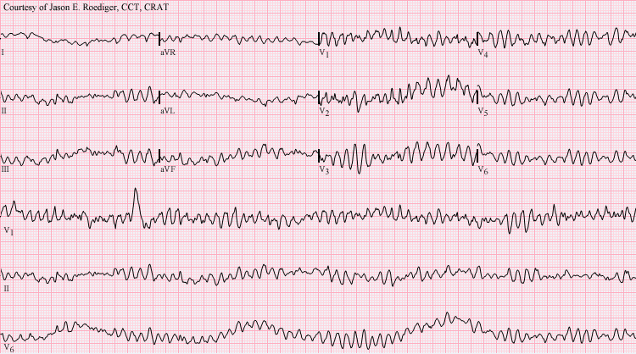
Ventricular tachycardia
Heart is beating so fast that not much blood is being circulated – not enough time to refill.
Signs
Palpations
Lightheadedness
Chest pain
Can lead to ventricular fibrillation
Causes:
Coronary artery disease
High potassium ( and other electrolytes)
Scar tissue

Slide 42
Heartbeat Dance
https://www.youtube.com/watch?v=x5oq4ErAmW0

Slide 43
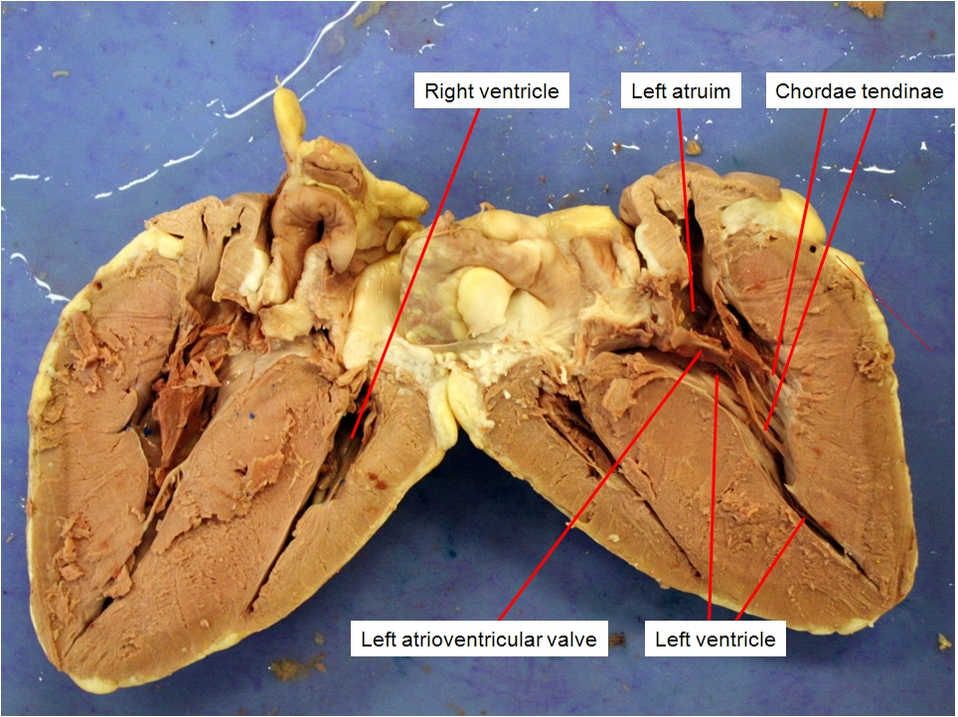
Activities
Perform EKG using Vernier EKG equipment.
Follow instructions in Survival Guide and calculate mean electrical axis of the heart.
Dissect sheep heart.
Study models and identify structures.
Notes:
Vernier image retrieved from http://2.bp.blogspot.com/_aLnunV6-RSU/Sjr00Omhi4I/AAAAAAAAAqg/Me5HokuIv2c/s200/manwbc.jpg, 2016
Sheep’s heart retrieved from https://b51ab7d9e5e1e7063dcb70cee5c33cf7f4b7bad8.googledrive.com/host/0Bx6hk6AUBHxDc2d4TDJZTFIyMGs/files/Bio%20102/Bio%20102%20Laboratory/Mammal%20Organs/sheep_heart_2.jpg, 2016

Slide 46
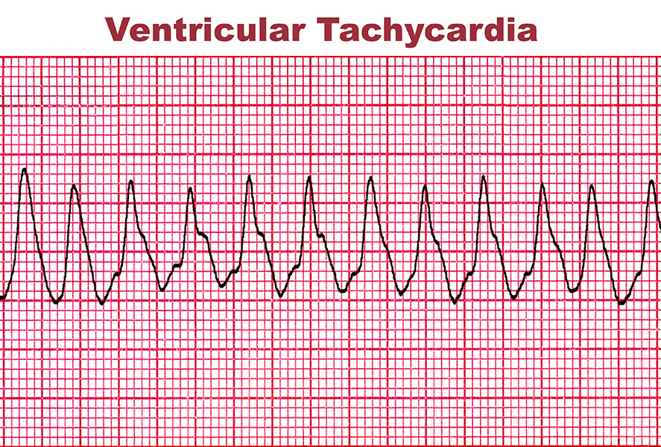

Slide 48
https://www.youtube.com/watch?v=_F3HGwpL7uY

Slide 49
Works Cited
Marieb, E. N. (2012). Essentials of human anatomy & physiology
(6th ed.). Boston: Pearson Education, Inc.
Marieb, E.N., Mitchell, S.J. & Smith, L.A. (2012). Human anatomy and physiology laboratory manual (10th ed.). Boston: Pearson Education, Inc.
Martini, F., Nath, J. & Bartholomew, E.F. (2012). Fundamentals of anatomy & physiology (9th ed.). Boston: Pearson Education, Inc.
McPhee, J. & Papadakis, M. (2012) Current medical diagnosis & treatment (51st ed.). New York: McGraw Hill.
Patton, T. & Thibodeau, G. (2013). Anatomy & physiology (8th ed.).
St. Louis:Mosby Elsevier.
Saladin, K. S. (2012). Anatomy & physiology: The unity of form and function (6th ed.). New York: McGraw Hill.
Tortora, G.J. & Derrickson, B.H. (2012). Principles of anatomy and physiology (13th ed.). Hoboken, NJ: Wiley

